Slide 1
Self Paced Reading of Bare Plural and Singular Kinds in Brazilian Portuguese
Third International Conference on Bare Nominals: Theory and Experiment
Sílvia Pereira Thiago Motta Sampaio Roberta Pires Aniela França
www.acesin.letras.ufrj.br
www.lapex.net.br

Slide 2
Experiment 1:
Defined Kinds

Slide 3
Experiment 1: Well Defined Kinds
THE IDEA:
Inner Kind Comparison
Non Kind Comparison
Roupa – Camisa Cloth – Shirt
Queijo – Parmes ão Cheese – Parmesan
Baleia – Orca Whale – Killer Whale
Brasileiro - Paulista Brazilian – Someone from S. Paulo
Roupa – Brinquedo Cloth – Toy
Queijo - Salame Cheese - Salami
Baleia - Foca Whale – Dolphin
Brasileiro – Japonês Brazilian - Japanese
Notes:
3

Slide 4
Experiment 1: Well Defined Kinds
METHODS: Participants
24 brazilian volonteers (11 male and 13 female)
9 female from Languages
7 male from Languages
4 female from Biblioteconomy
4 male from Engineering
18-25 yo
Normal or corrected to normal vision
Notes:
4

Slide 5
Experiment 1: Well Defined Kinds
METHODS: Stimuli
4 versions of 8 groups of sentences:
- Singular Kind-InnerKind (greenery - lettuce) - Singular Kind-Kind (greenery – vegetable)
- Plural Kind-InnerKind (greeneries – lettuces) - Plural Kind-Kind (greeneries – vegetables)
Examples:
a) Embora não tenha verdura na feira, tem alface na barraca da feira adversative there is no greenery in the market, there is lettuce in the market stand
b)Embora não tenha verdura na feira, tem legume na barraca da feira
vegetable
c)Embora não tenham verduras na feira, têm alfaces na barraca da feira (Plural of A)
d) Embora não tenham verduras na feira, têm legumes na barraca da feira (Plural of B)
Notes:
5

Slide 6
Experiment 1: Well Defined Kinds
METHODS: Stimuli
Fillers
- 1/3 of experimental sentences (including Experiments 1 and 2)
1/3 of sentences with similar structure including sentences of other experiments.
1/3 of filler sentences
Notes:
6

Slide 7
Experiment 1: Well Defined Kinds
METHODS: Stimuli and Task
This Experiment ran in the app Psyscope X B57 using a Macbook White Unibody 14” 2.4 GHz Intel Core 2 Duo, 2Gb 667MHz DDR2 SDRAM running Mac OSX 10.5.8 Leopard;
Stimuli were presented in a Word-by-Word Self Paced Reading with an interpretation question at the end of each stimulus;
The volonteers use the [spacebar - in yellow] to navigate between the words of the sentence and the [k] and [l] to answer [yes] or [no] respectively.
Stimuly were presented in a black background
Font: Times New Roman 24 white.
Notes:
7

Slide 8
+
1s

Slide 9
Embora

Slide 10
não

Slide 11
tenha

Slide 12
verduras

Slide 13
na

Slide 14
feira,

Slide 15
tem

Slide 16
legumes

Slide 17
na

Slide 18
barraca

Slide 19
da

Slide 20
feira

Slide 21
Tem verdura na feira? (Is there greenery in the market?)

Slide 22
Experiment 1: Well Defined Kinds
METHODS: Data Analysis
We analysed the psyscope log data in the Ms Excel 2010;
We considered the words 8-12 as the critical area due to the critical NP (Seg 8) and its Spill-Over (Segs 9-12);
We observed the Sum of the Averages of the times of each word, of the critical area and of the Reaction Times in order to build the graphics;
Significance tested with bicaudal T-Student Test type 1 in the Ms Excel for each pair of data.
Times < 200ms and > 7s were removed as outliers
We considered the following levels of significance:
High: P-value <0.02
Medium: P-value <0.05
Low: P-value <0.08
No Significance: P-value ≥0.08

Slide 23
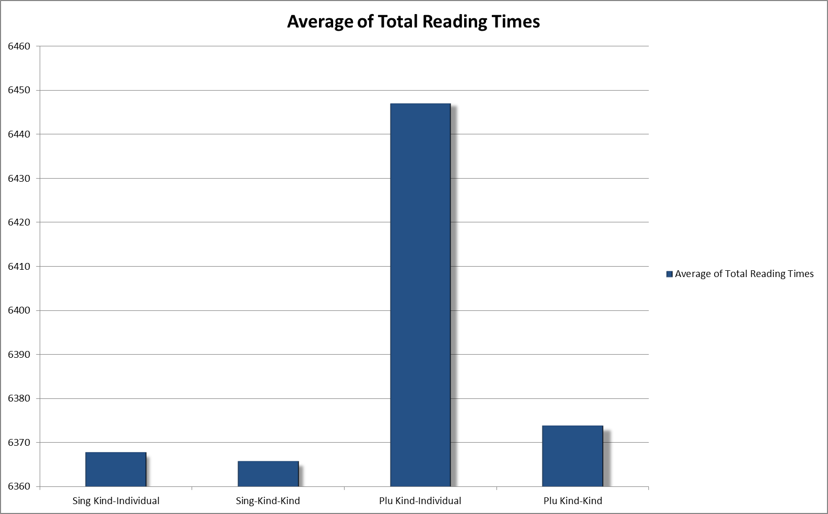
Experiment 1: Well Defined Kinds
METHODS: Results
Increase of total reading times for Plural Kind-InnerKind Condition

Slide 24
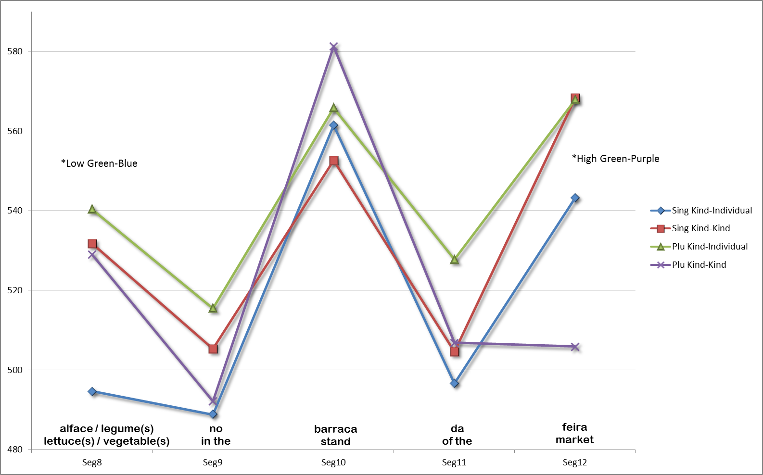
Experiment 1: Well Defined Kinds
Not significative increase of the reading times for the locative NP for Plural Kind-InnerKind
Significative increase for the Plural Kind-InnerKind compared to Plural Kind-Kind and Singular Kind-InnerKind
METHODS: Results
The critical NP time in Kind-InnerKind Condition increases for the Plural Condition
and Red- Purple

Slide 25
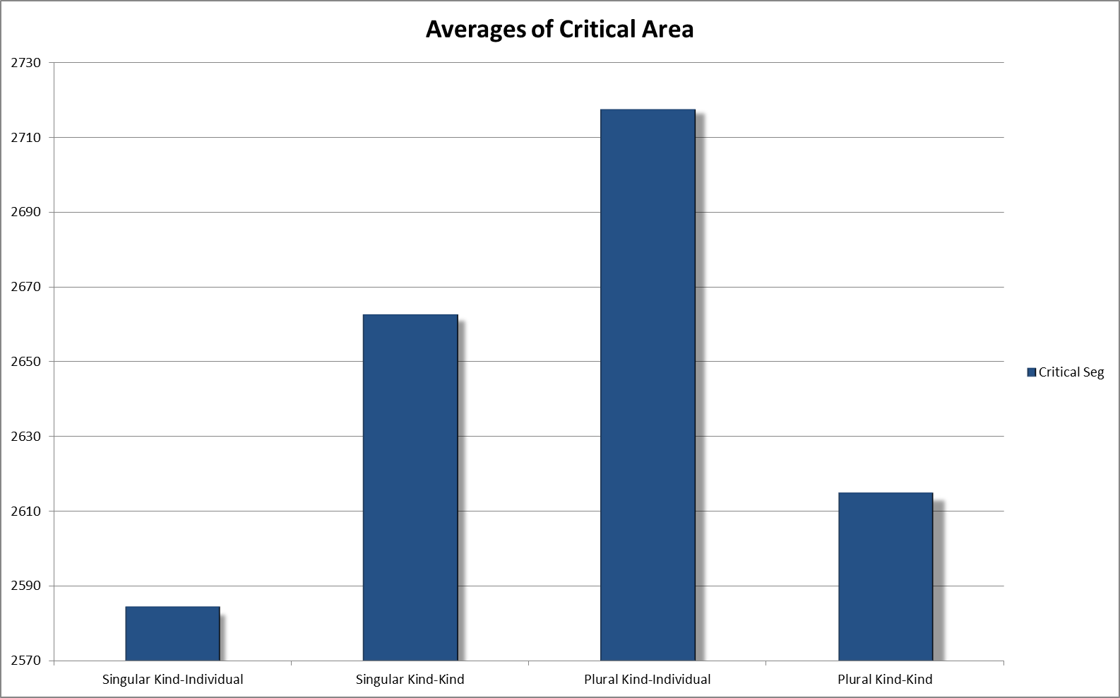
Experiment 1: Well Defined Kinds
METHODS: Results
However, the effect for the Singular Conditions is
the inverse!!
*
*
Increase of Reading times for the critical area for Plural Kind-InnerKind may indicate the difficult to process the “negation” of the matrix clause sense.
“There are no greeneries but there are lettuces”

Slide 26
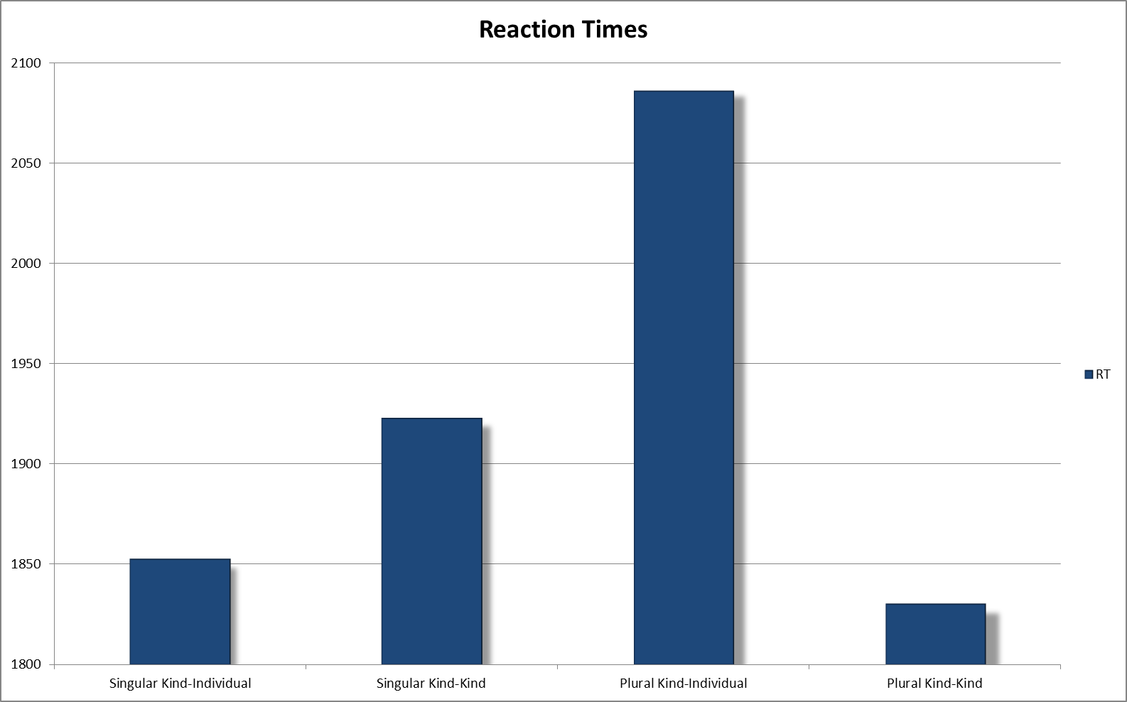
Experiment 1: Well Defined Kinds
METHODS: Results
*
In RTs analysis we found the same effect for both comparisons but only the plural condition reach significance

Slide 27
Experiment 1: Well Defined Kinds
DISCUSSION:
1) The increasing reading and reaction times only for the plural conditions may indicate that plurals are more difficult to read than the singulars.
2) We expected to find an effect of the negation of the matrix clause, however, if there is some effect, we can find it only for the plural conditions.
2) It may indicate that bare singular generics are less complex than the bare plural generics so we can dismember the inner kind NP from the gender expressed in the matrix clause of the singular conditions, but not from the plural ones.

Slide 28
Experiment 2:
Not-Well Defined Kinds
Krifka (1995) apud. Ionin, Montrul & Santos (2011: 116)

Slide 29
Experiment 2: Not Well Defined Kinds
THE IDEA:
Inner Kind Comparison
Non Kind Comparison
Livro Novo – Livro Antigo New Book – Old Book
Pomada Cara – Pomada Barata Expensive Ointment – Cheap Ointment
Urso Zangado – Urso Faminto Angry Bear – Starving Bear
Livro Novo – Gibi Antigo New Book – Old Comic
Pomada Cara – Xarope Barato Expensive Ointment – Cheap Syrup
Urso Zangado – Leão Faminto Angry Bear – Starving Lion
Notes:
29

Slide 30
Experiment 2: Not Well Defined Kinds
METHODS: Stimuli
4 versions of 8 groups of sentences:
- Singular Kind-Same Kind (angry bear – starving bear) - Singular Kind-Kind (angry bear – starving lion)
- Plural Kind-Same Kind (angry bears – starving bears) - Plural Kind-Kind (angry bears – starving lions)
Examples:
a) Embora não tenha urso zangado no parque, tem urso faminto na jaula do parque adversative there is no angry bear in the park, there is starving bear in the cage of the park
b)Embora não tenha urso zangado no parque, tem leão faminto na jaula do parque
lion
c)Embora não tenham ursos zangados no parque, têm ursos famintos na jaula do parque (Plural of A)
d) Embora não tenham ursos zangados no parque, têm leões famintos na jaula do parque (Plural of B)
Notes:
30

Slide 31
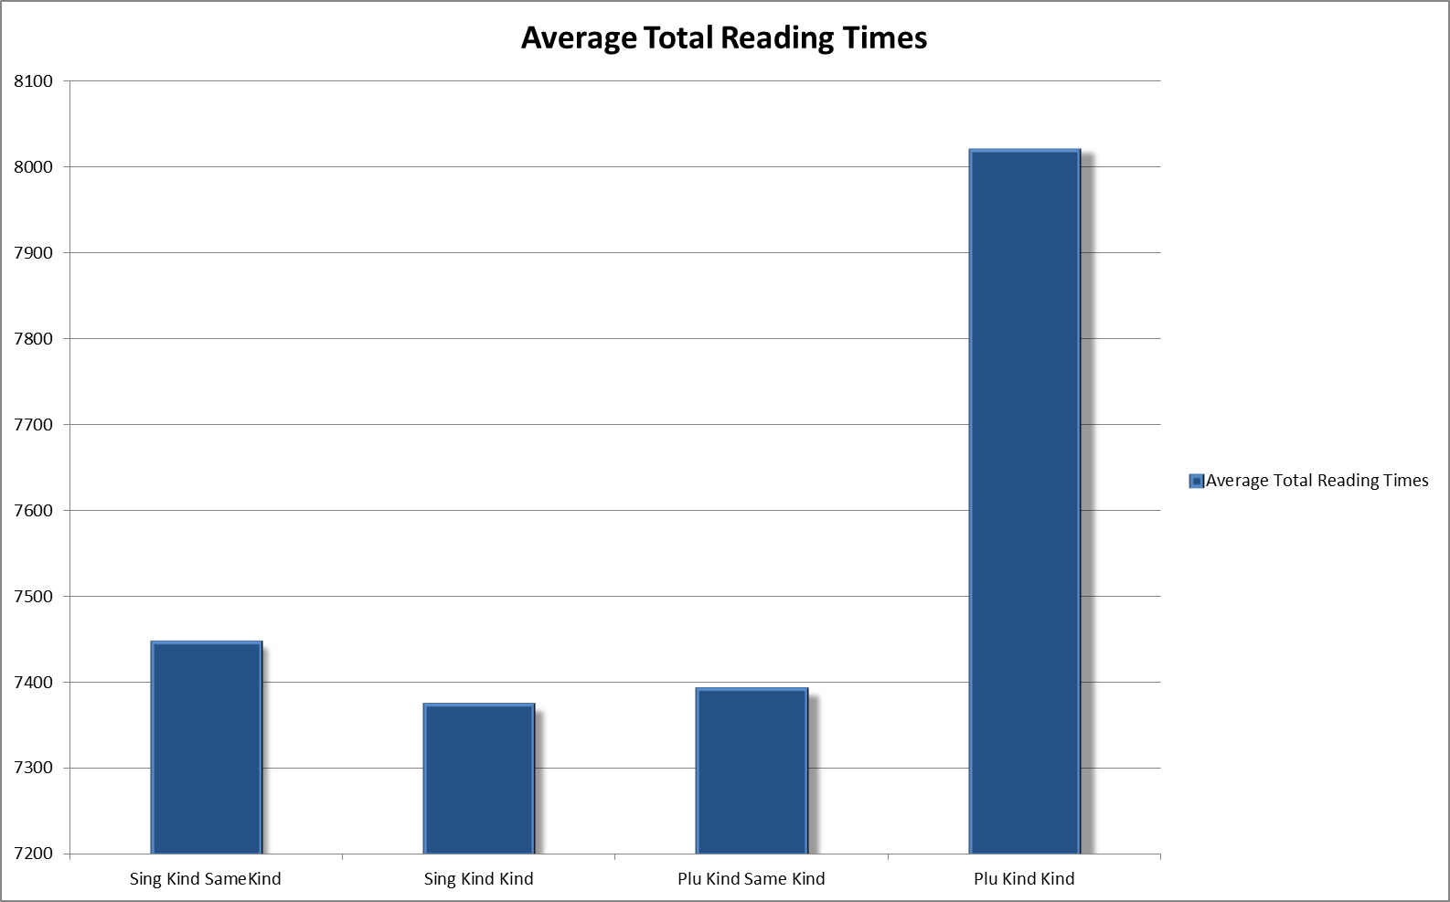
Experiment 2: Not Well Defined Kinds
METHODS: Results
Larger total reading time for Plural Kind Kind condition.
In Experiment 1 the larger time was relative to the Kind-SameKind
Notes:
31

Slide 32
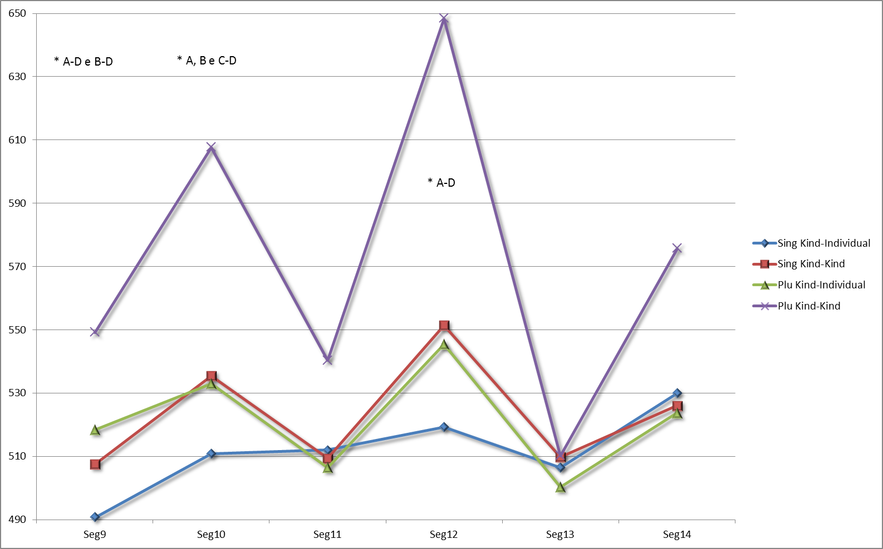
Experiment 2: Not Well Defined Kinds
Plural Kind-Kind condition require more time to be processed in almost every word in the critical area.
Larger time for every NP.
METHODS: Results
Bear angry in the cage of the park
A B C D
Notes:
32

Slide 33
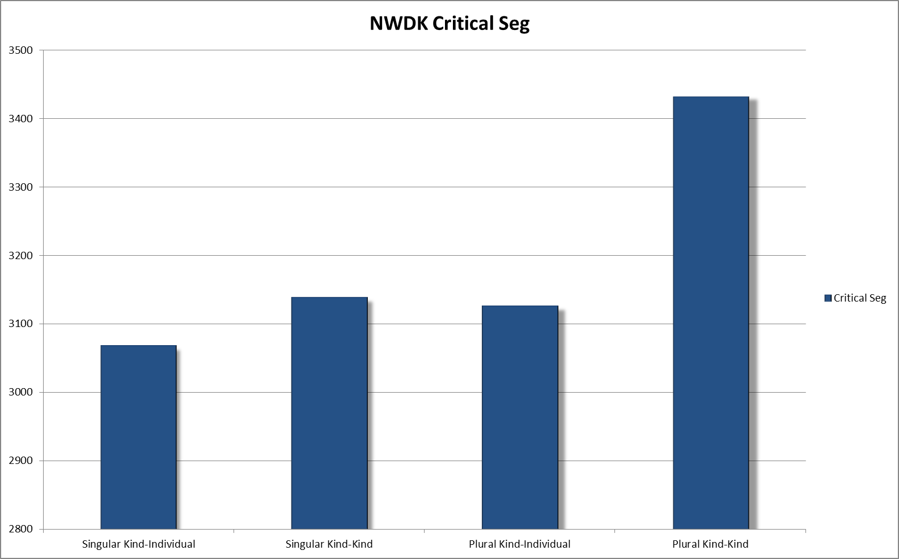
Experiment 2: Not Well Defined Kinds
METHODS: Results
*
Significance for the larger time of the critical area compared to the other conditions
Notes:
33

Slide 34
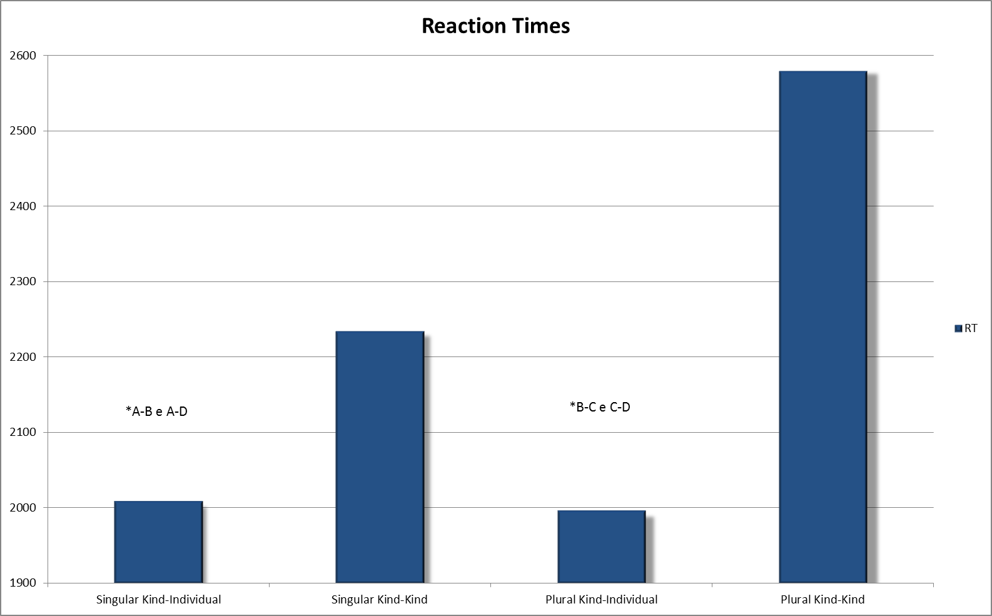
Experiment 2: Not Well Defined Kinds
METHODS: Results
*B-D
In RTs analysis we found the same effect for both comparisons.
Larger times for Kind-Kind conditions
Larger times for plural Kind-Kind condition compared to Singular Kind-Kind.
D
B
A
C
Notes:
34

Slide 35
Experiment 2: Not Well Defined Kinds
Discussion:
Against the results in the experiment 1, in this expriment the Kind-Kind conditions are the ones presenting an increase in processing times.
The behaviour of Kind-SameKind conditions may reflect na effect of facilitation due to the repetition of the same word with a “subkind specification” (angry bear / starving bear). So the Kind-Kind conditions that do not repeat the NP present larger times than the Kind-SameKind conditions.
Again, we found na increasing in the process of plurals compared to the Singular condition. However only the Kind-Kind condition presented this difficulty.
Notes:
35

Slide 36
Experiment 2: Not Well Defined Kinds
METHODS: Results
Notes:
36

