Slide 1
Oliveira Motta
Motta Sampaio
Thiago

Slide 2
Psychophysical and MEG effects of duration incongruences in Language Processing
Neuro-Breakfast
Thiago Oliveira Motta Sampaio
25/02/2013

Slide 3
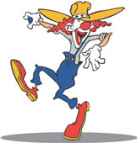
Aspectual Coercion?
What happens if someone says something as:
The Clown jumped for 10 minutes?
This trick work just for non-resultative punctuals
John dived all the day long
?The car crashed for 10 minutes
?The jar broke all the day long
Notes:
3

Slide 4
Todorova et al. (2000)
Self-paced reading
Even though / Howard [sent / a large check] / to his daughter / [for many years] / , she refused to accept his money
Even though / Howard [sent / large checks] / to his daughter / [for many years] / , she refused to accept his money
Even though / Howard [sent / a large check] / to his daughter / [last year], / she refused to accept his money
Even though / Howard [sent / large checks] / to his daughter / [last year], / she refused to accept his money
Twice of rejection for “iterative coercion” condition in (a) than for other conditions (19%, 7%, 8% e 9%), and longer reading times in temporal modifiers area.
Notes:
4

Slide 5
Brennan & Pylkkanen 2008
More trustful stimuli: Pre test of “punctuality judgement”
1-7 scale - only verbs 1-3 used in the stimuli;
Plausibility Pre-test
Main test Task: Gramaticality judgement
: 141-142

Slide 6
MEG
Brennan & Pylkkanen 2008
Areas showing reliably increased activity for the Coercion condition in the distributed source analysis.
Earlier right-lateral frontal, anterior temporal and posterior temporal/cerebellar effect at 340–380ms
And a later anterior midline effect at 440–460 ms

Slide 7
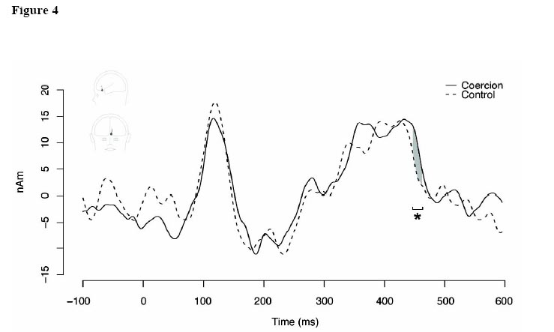
MEG
Grandaveraged source waveforms for the AMF spatial ﬁlter applied to the MEG data
Notes:
7

Slide 8
Some Points
1) Is there an influence of temporal context position? Can we boost Coercion(?) effect?
2) Why coercion is related just to punctual events? Do we have the same effect for durative events?
3) Do we have the same effect for isolated words? If so, we can delimit the locus of the effect in the timecourse of linguistic computation.
4) All these experiments were made in English
- Which verbs we can use for French? - Is an explicit punctuality judgement really the better way to choose verbs?

Slide 9
Todorova et al. (2000)
Self-paced reading
Even though / Howard [sent / a large check] / to his daughter / [for many years] / , she refused to accept his money
Even though / Howard [sent / large checks] / to his daughter / [for many years] / , she refused to accept his money
Even though / Howard [sent / a large check] / to his daughter / [last year], / she refused to accept his money
Even though / Howard [sent / large checks] / to his daughter / [last year], / she refused to accept his money
Twice of rejection for “iterative coercion” condition in (a) than for other conditions (19%, 7%, 8% e 9%), and longer reading times in temporal modifiers area.
Notes:
9

Slide 10
Brennan & Pylkkanen 2008
More trustful stimuli: Pre test of “punctuality judgement”
1-7 scale - only verbs 1-3 compose the stimuli;
Plausibility Pre-test
Main test Task: Gramaticality judgement
: 141-142

Slide 11
Garden Path
While Nancy was dressing the baby played in the garden.
The government plans to raise taxes were defeated.
The baby played in the garden while Nancy was dressing
All morning long, the cart banged in the cramped store aisle
The cart banged all morning long in the cramped store aisle

Slide 12
Todorova et al. (2000)
Self-paced reading
Even though / Howard [sent / a large check] / to his daughter / [for many years] / , she refused to accept his money
Even though / Howard [sent / large checks] / to his daughter / [for many years] / , she refused to accept his money
Even though / Howard [sent / a large check] / to his daughter / [last year], / she refused to accept his money
Even though / Howard [sent / large checks] / to his daughter / [last year], / she refused to accept his money
Twice of rejection for “iterative coercion” condition in (a) than for other conditions (19%, 7%, 8% e 9%), and longer reading times in temporal modifiers area.
Notes:
12

Slide 13
Some Points
1) Is there an influence of temporal context position? Can we boost Coercion(?) effect?
2) Why coercion is related just to punctual events? Do we have the same effect for durative events?
3) Do we have the same effect for isolated words? If so, we can delimit the locus of the effect in the timecourse of linguistic computation.
4) All these experiments were made in English
- Which verbs we can use for French? - Is an explicit punctuality judgement really the better way to choose verbs?

Slide 14
Aristotle
a) Telic Events (Kinesis) John arrives today
b) Atelic Events (Energeia) John works today
Vendler 1967
Vendlerian Classes
States to know, to be red, to love,
Accomplishments (result) to clean, to draw
Activities (no result) to run, to work
Achievements (result) to break, to explode,
Semelfactives (no results) to wink, to hop
Non-Events
Durative Events
Punctual Events

Slide 15
+
1s

Slide 16
três

Slide 17
[minutes / months]

Slide 18
no

Slide 19
palco

Slide 20
Isabelle dançou? (Did Isabelle danced?)

Slide 21
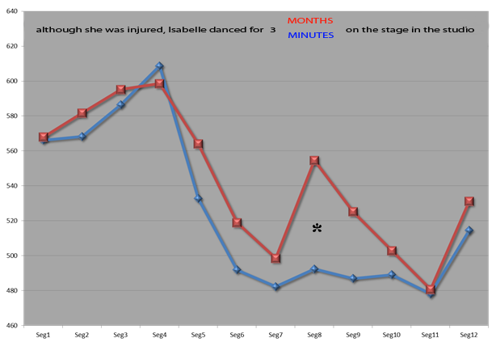
Exp 1
Embora estivesse machucada, Isabelle dançou por 3 [time period] no palco do estúdio

Slide 22
Exp 2
(17) Carla caminhou por dez [time period] na praia de Ipanema
Carla walked for ten [time period] on Ipanema Beach
Task: simple questions = Carla walked on Ipanema Beach? [yes/no]
(18) Time periods:
[minutes]: Eventuality reading, the event (the walk) happened only once ex. Carla often travels to Rio de Janeiro and once she took a walk for 10 minutes on Ipanema Beach.
b. [days]: Habitual eventuality reading, habitual reading in an eventual limited time
ex. Carla has traveled a lot to Rio and she (always) stayed there for some days. Each day she took a walk on Ipanema Beach
c. [months] – habitual reading
ex. Carla lives in Rio and, for the last ten months, she usually took a walk on Ipanema Beach.
d. [years] – larger habitual reading
ex. Carla lives in Rio and, for the last ten years, she usually took a walk on Ipanema Beach.

Slide 23
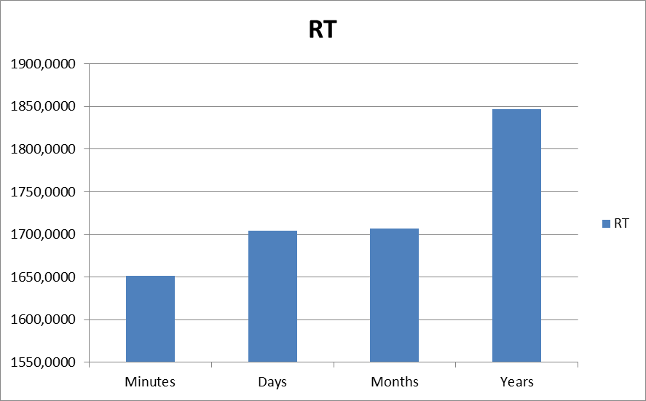
No significance

Slide 24
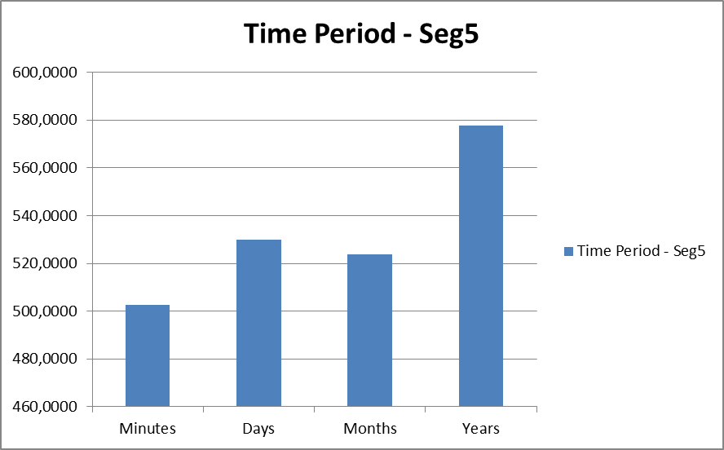
* p=,033

Slide 25
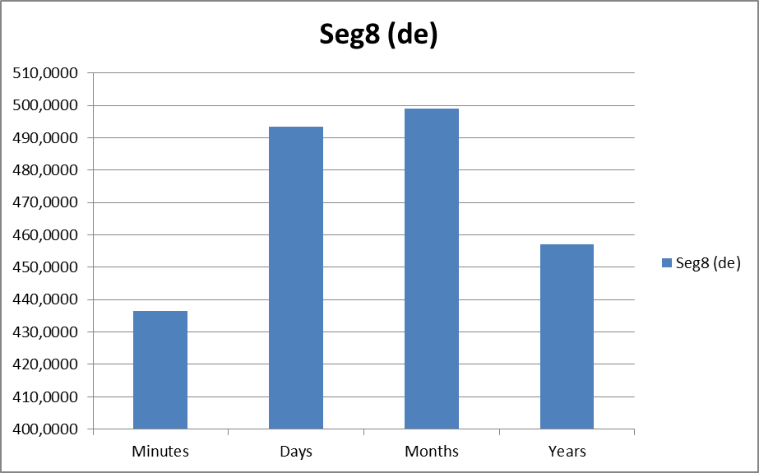
of
p= ,001
p=,004

Slide 26
Some Points
1) Is there an influence of temporal context position? Can we boost Coercion(?) effect?
2) Why coercion is related just to punctual events? Do we have the same effect for durative events?
3) Do we have the same effect for isolated words? If so, we can delimit the locus of the effect in the timecourse of linguistic computation.
4) All these experiments were made in English
- Which verbs we can use for French? - Is an explicit punctuality judgement really the better way to choose verbs?

Slide 27
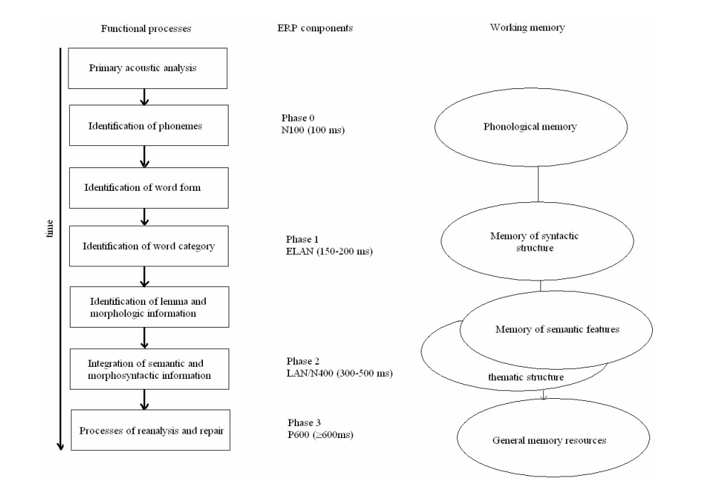
Adapted from Friederici 2002 Timecourse of Linguistic computation
Notes:
27

Slide 28
Some Points
1) Is there na influence of temporal context position? Can we boost Coercion(?) effect?
2) Why coercion is related just to punctual events? Do we have the same effect for durative events?
3) Do we have the same effect for isolated words? If so, we can delimit the locus of the effect in the timecourse of linguistic computation.
4) All these experiments were made in English
- Which verbs can I use for French? - Is an explicit punctuality judgement really the better way to choose verbs?

Slide 29
Greenwald 2001 http://faculty.washington.edu/agg/pdf/RevisedTop10.29Jan04.pdf

Slide 30
punctuel
durative
marcher

Slide 31
seconde
minute
marcher

Slide 32
punctuel seconde
durative minute
marcher

Slide 33
punctuel heure
durative seconde
marcher

Slide 34
Version Blocks | 1 | 2 | 3 | 4 | 5 | 6
A | punctual durative | durative punctual | sec-min | min-sec | sec min punc dur | min sec punc dur
B |  |  | min-heure | heure-min | min heu punc dur | heu min punc dur
C |  |  | jour-heu | heu-jour | heu jour punc dur | jour heu punc dur
D |  |  | sec - heu | heu – sec | sec heu punc dur | heu sec punc dur
E |  |  | sec - jour | jour – sec | sec jour punc dur | jour sec punc dur
F |  |  | min - jour | jour - min | min jour punc dur | jour min punc dur

Slide 35
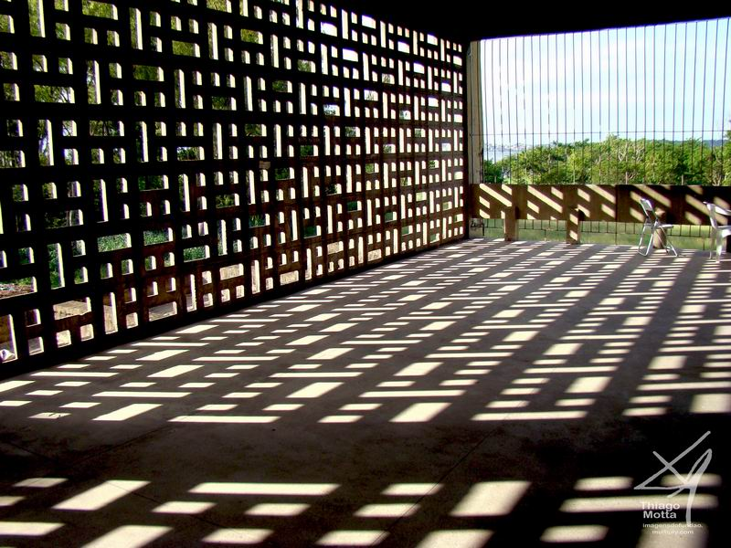
Thank you for your Time!
motta@ufrj.br

